Slide 1


Session 5: Network Analysis and Scheduling
Dr Andre Samuel

Slide 2







Learning Outcomes

Slide 3
Recap

Slide 4
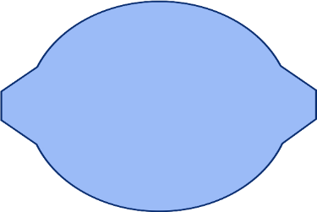


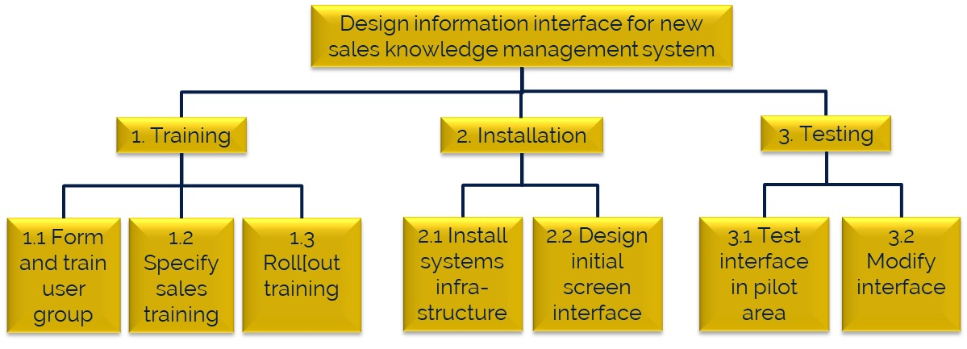
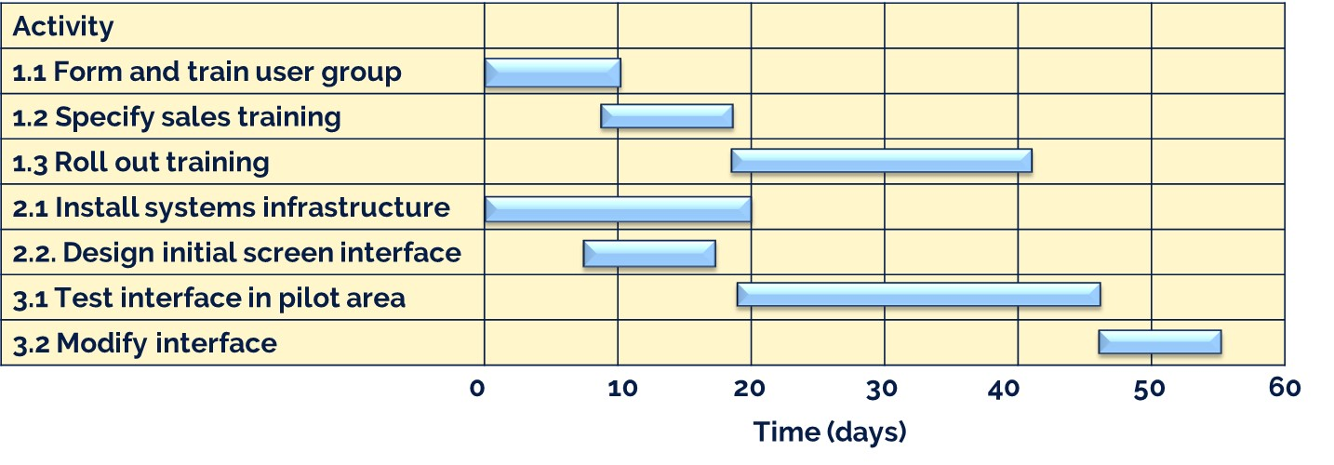
WBS to Schedule
Monitoring &
Controlling Processes
Integrated Planning
Project Start Up
Project Close
Managing Deployment
Work breakdown structure – shows what? But not, when?
Schedule – shows also the when, commonly Gantt charts are used:

Slide 5
Gantt chart (schedule)
Monitoring &
Controlling Processes
Integrated Planning
Project Start Up
Project Close
Managing Deployment
Activity
1.1 Form and train user group
1.2 Specify sales training
1.3 Roll out training
2.1 Install systems infrastructure
2.2. Design initial screen interface
3.1 Test interface in pilot area
3.2 Modify interface
0
10
20
30
40
50
60
Time (days)

Slide 6
Network Analysis

Slide 7
Introduction to Network Analysis
Network Analysis or as it is also known Critical Path Analysis is widely used as a project management tool.
Network Analysis is used by project managers to plan and allocate resources to minimise total project duration and project costs.
1. Identify all the activities that need to be undertaken as part of the project
2. Estimate the time it will take to complete an activity
3. Identify order in which activities must be completed (relationships and dependencies)
4. Construct a network diagram
5. Calculate project duration

Slide 8
Terminology
Activity - A specific task or set of tasks that are required by the project, use up resources, and take time to complete.
Network - The combination of all activities that define the project and the sequence of relationships between them.
Milestone - A zero duration activity (task) which does not involve any work but which is nonetheless important as a key achievement e.g. Contract Award, Project Completion.
Critical - Activities, events, or paths which, if delayed, will delay the completion of the project. A project’s critical path is understood to mean that sequence of critical (slowest) activities that connect the project’s start activity to its finish activity.

Slide 9
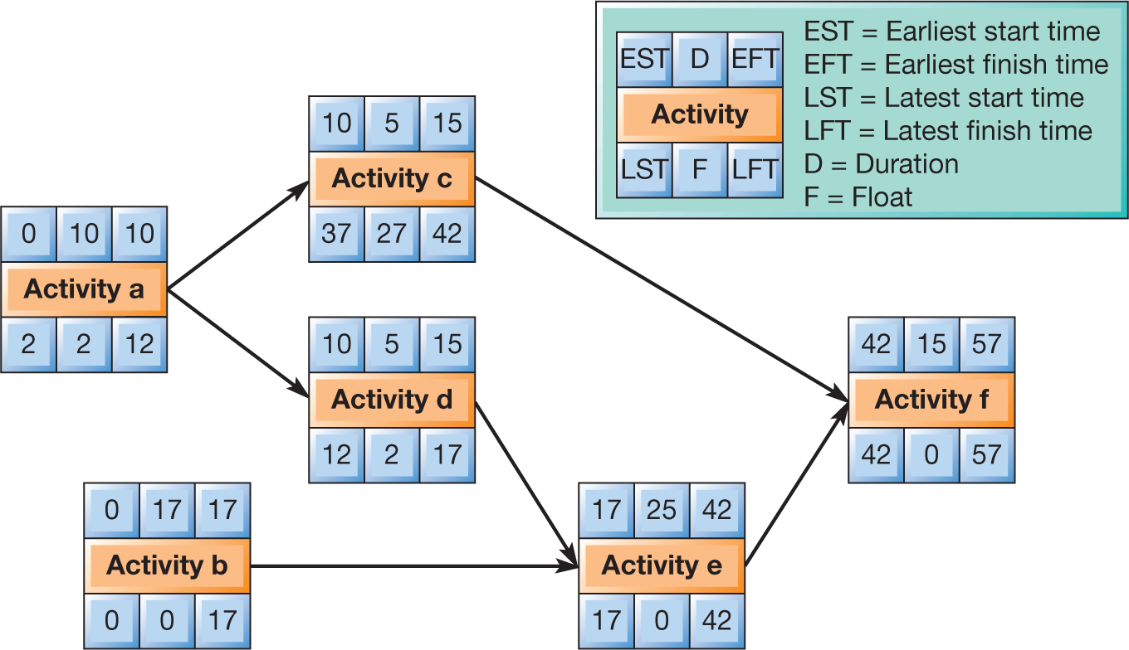
Example of a network diagram
Notes:
Figure 19.15 Critical path analysis (AoN method) for the project to design an information interface for a new sales knowledge management system in an insurance company

Slide 10
Let’s have a go together
New office complex
Recommended – have the “Follow along New Office Complex Network Diagram” ready/open
1. Identify all the activities that need to be undertaken as part of the project
2. Estimate the time it will take to complete an activity
3. Identify order in which activities must be completed (relationships and dependencies)
4. Construct a network diagram
5. Calculate project duration

Slide 11
1. Identify all the activities that need to be undertaken as part of the project 2. Estimate the time it will take to complete an activity
In the building of a new office complex the following activities were identified and their durations quantified.
Activity | Description | Duration (Days)
A | Dig & Lay foundations | 12
B | Lay Drive | 3
C | Construct Walls | 20
D | Carpenters Put on Roof | 4
E | Roofers Lay Tiles | 5
F | Finish Carpentry Work | 12
G | Install Water Pipes | 7
H | Plastering of Walls | 8
I | Decoration | 8
J | Tiles Fitted | 4
K | Carpets Fitted | 2
L | Wiring Completed | 8
M | Project completed | 0

Slide 12
3. Identify order in which activities must be completed (relationships and dependencies)
The various activities can arranged into a logical sequence and represented in what is referred to as a precedence table.
Activity | Predecessor (Preceding Activity)
A | *
B | A
C | A
D | C
E | D
F | H
G | E
H | L,G
I | F,K
J | H
K | J
L | E
M | B,I
This table indicates what activity must be completed before a related activity can take place.
This table indicates the order of all activities and the relationship between the different activities. This table tells you that activity C must be preceded by activity A.
This means in this instance that the foundations must be laid before the walls can be constructed.
*Activity A has no preceding activity and therefore is the starting activity.

Slide 13
4. Constructing a Network Diagram
B
More than one activity can follow another: B and C can start once A is finished.
A
C
A
More than one activity can finish before another can start: C may only start once A and B are both complete.
C
B
Activities running in parallel are the norm in network diagrams: this reflects the reality of how projects actually proceed.

Slide 14
Sketch the Network Diagram
Consider the office complex example. Below is a table of information received so far….
Activity | Predecessor (Preceding Activity) | Duration
A | * | 12
B | A | 3
C | A | 20
D | C | 4
E | D | 5
F | H | 12
G | E | 7
H | L,G | 8
I | F,K | 8
J | H | 4
K | J | 2
L | E | 8
M | B,I | 0
Task: Can you sketch out the network?

Slide 15
Example of Sketched Network
Consider the office complex example. Below is a table of information received so far….
Activity | Predecessor (Preceding Activity) | Duration
A | * | 12
B | A | 3
C | A | 20
D | C | 4
E | D | 5
F | H | 12
G | E | 7
H | L,G | 8
I | F,K | 8
J | H | 4
K | J | 2
L | E | 8
M | B,I | 0
Task: Can you sketch out the network?
B
L
F
I
M
A
C
D
E
H
G
J
K

Slide 16
Naming conventions
Same data:
Activity | Predecessor (Preceding Activity) | Duration
A | * | 12
B | A | 3
C | A | 20
D | C | 4
E | D | 5
F | H | 12
G | E | 7
H | L,G | 8
I | F,K | 8
J | H | 4
K | J | 2
L | E | 8
M | B,I | 0
The first thing to do is to construct the network diagram
Naming Convention For Nodes
Earliest Start Time
EST | D | EFT
Activity
LST | F | LFT
Duration
Latest Finish Time

Slide 17
The network diagram (with no information) – Recommended – use the “Follow along New Office Complex Network Diagram
EST | D | EFT
M
LST | F | LFT
EST | D | EFT
B
LST | F | LFT
EST | D | EFT
A
LST | F | LFT
EST | D | EFT
L
LST | F | LFT
EST | D | EFT
F
LST | F | LFT
EST | D | EFT
I
LST | F | LFT
F
EST | D | EFT
C
LST | F | LFT
EST | D | EFT
D
LST | F | LFT
EST | D | EFT
E
LST | F | LFT
EST | D | EFT
H
LST | F | LFT
G
EST | D | EFT
G
LST | F | LFT
J
K
EST | D | EFT
J
LST | F | LFT
EST | D | EFT
K
LST | F | LFT
From the network the order of activities can be identified (by each letter) and the associated duration of each activity
Add the durations

Slide 18
Durations added
EST | 0 D | EFT
M
LST | F | LFT
EST | 3 D | EFT
B
LST | F | LFT
EST | 12 D | EFT
A
LST | F | LFT
EST | 8 D | EFT
L
LST | F | LFT
EST | 12 D | EFT
F
LST | F | LFT
EST | 8 D | EFT
I
LST | F | LFT
F
EST | 20 D | EFT
C
LST | F | LFT
EST | 4 D | EFT
D
LST | F | LFT
EST | 5 D | EFT
E
LST | F | LFT
EST | 8 D | EFT
H
LST | F | LFT
G
EST | 7 D | EFT
G
LST | F | LFT
J
K
EST | 4 D | EFT
J
LST | F | LFT
EST | 2 D | EFT
K
LST | F | LFT
Durations added into top middle box

Slide 19
Forward Pass
Calculating EST and EFT

Slide 20
Add the earliest start times
Although this network diagram provides us with some information, as project managers we would still need information such as the earliest start times for the various activities. That is how soon each of our activities can begin.
The calculation of earliest start times can give the project manager information that will allow for a greater understanding of how long the total project might take, and also contribute to a greater understanding of what activities are critical to the success of the project.

Slide 21
Earliest Start Times Work Left to Right
Earliest start times are calculated by working Left to Right through the network diagram.
Always start with the first activity with it’s starting time of 0.
The earliest starting time of each activities is dependent on the duration of the preceding activities . So in our office complex example:
The earliest time activity B can begin is dependent on how long activity A takes which is 12 days.
Therefore the EST for B (and C) is 12 days.
And by following logic the EST for D is 32 days (i.e. 12 + 20).
12 EST | 3 D | 15 EFT
B
LST | F | LFT
0 EST | 12 D | 12 EFT
A
LST | F | LFT
12 EST | 20 D | 32 EFT
C
LST | F | LFT
EST | 4 D | EFT
D
LST | F | LFT

Slide 22
Earliest Start Times Use the later date
Adding ESTs to the diagram is relatively simple until you reach a point at which there are two or more activities preceding another.
In this diagram the activity H is dependent upon two preceding activities G & L so common sense should dictate that the EST for H must be the later of the preceding options - in this case 49.
41 EST | 8 D | 49 EFT
L
LST | F | LFT
use the later one
F
49 EST | 8 D | 57 EFT
H
LST | F | LFT
41 EST | 7 D | 48 EFT
G
LST | F | LFT

Slide 23
Table of Earliest Start Times
It is often advisable to set out Earliest Start Time calculations in a table format before adding them to a diagram. The Earliest Start Times for our office complex example and their calculation is performed below:
Activity | Previous Actvity's EST | Previous Activity's Duration | EST
A |  |  | 0
B | 0 | 12 | 12
C | 0 | 12 | 12
D | 12 | 20 | 32
E | 32 | 4 | 36
F | 49 | 8 | 57
G | 36 | 5 | 41
H | 41 or 41 | 7 or 8 | 49
I | 57 or 61 | 12 or 2 | 69
J | 49 | 8 | 57
K | 57 | 4 | 61
L | 36 | 5 | 41
M | 12 or 69 | 3 or 8 | 77
This shows that the earliest possible completion time for the project is 77 days.

Slide 24
Constructing a Network Diagram with Earliest Start and Finish Times
77 EFT | 0 D | 77 EFT
M
LST | F | LFT
12 EST | 3 D | 15 EFT
B
LST | F | LFT
0 EST | 12 D | 12 EFT
A
LST | F | LFT
41 EST | 8 D | 49 EFT
12 EST
LST | F | LFT
57 EST | 12 D | 69 EFT
F
LST | F | LFT
69 EST | 8 D | 77 EFT
I
LST | F | LFT
12 EST | 20 D | 32 EFT
C
LST | F | LFT
32 EST | 4 D | 36 EFT
D
LST | F | LFT
36 EST | 5 D | 41 EFT
E
LST | F | LFT
49 EST | 8 D | 57 EFT
H
LST | F | LFT
G
41 EST | 7 D | 48 EFT
G
LST | F | LFT
J
K
57 EST | 4 D | 61 EFT
J
LST | F | LFT
61 EST | 2 D | 63 EFT
K
LST | F | LFT
Earliest Start Time added

Slide 25
Reverse Pass
Calculating LST and LFT

Slide 26
Constructing a Network Diagram – Latest Finish Times
Although calculation of the ESTs gives us valuable information it is only part of the overall story. To give a greater level of information we need also to calculate the latest finish times of each activity.
The Latest Finish Time (LFT) of an activity is the latest time an activity can finish without prolonging the total project duration
If an activity exceeds its LFT then it will have a knock on effect on other activities latest finish times and eventually the overall project duration.

Slide 27
Latest Finish Times Work Right to Left
Calculation of the LFTs on a network diagram are performed Right to Left i.e. start at the last activity and subtract durations from the latest finish time.
77 EFT | 0 D | 77 EFT
M
77 LST | F | 77 LFT
69 EST | 8 D | 77 EFT
I
69 LST | F | 77 LFT
61 EST | 2 D | 63 EFT
K
67 LST | F | 69 LFT
Latest Finish Time of Final Activity
LST = LFT – Duration
The Latest Finish Time of Activity I is the latest start time of the following activity M
LST = 77-8= 69
The Latest Finish Time of Activity K is latest start time of activity I
LST = 69- 2 = 67
If there are more than one possible LST value then always select the lowest LST for an activity

Slide 28
Constructing a Network Diagram – Latest Finish Times
Consider activity H. the LFT for activity H is dependent upon the LSTs of two activities i.e. J and F.
The options available for the calculation are:
Using J’s LST = 63
Using F’s LST = 57
The lowest values should be chosen. If the higher value is selected then it would mean that activity H could finish on day 63.
If this happened then this would delay activity F’s LFT by a further six days, this would then delay I’s LFT by six days and so on.
57 EST | 12 D | 69 EFT
F
57 LST | F | 69 LFT
49 EST | 8 D | 57 EFT
H
49 LST | F | 57 LFT
K
57 EST | 4 D | 61 EFT
J
63 LST | F | 67 LFT

Slide 29
Table of Latest Finish Times
It is often advisable to set out Latest Finish Time calculations in a table format before adding them to a diagram. The Latest Finish Times for our office complex example and their calculation is performed below:
Activity | Following Activity's LFT | Following Activity's Duration | LFT
M | NA | 0 | 77
I | 77 | 0 | 77
K | 77 | 8 | 69
F | 77 | 8 | 69
J | 69 | 2 | 67
H | 69 or 67 | 12 or 4 | 57
L | 57 | 8 | 49
G | 57 | 8 | 49
E | 49 or 49 | 7 or 8 | 41
D | 41 | 5 | 36
C | 36 | 4 | 32
B | 77 | 0 | 77
A | 77 or 32 | 3 or 20 | 12
** If there are more than one possible LFT value then always select the lowest LFT for an activity.

Slide 30
Constructing a Network Diagram with Latest Finish Times
77 EFT | 0 D | 77 EFT
M
77 LST | F | 77 LFT
12 EST | 3 D | 15 EFT
B
74 LST | F | 77 LFT
0 EST | 12 D | 12 EFT
A
0 LST | F | 12 LFT
41 EST | 8 D | 49 EFT
12 EST
41 LST | F | 49 LFT
57 EST | 12 D | 69 EFT
F
57 LST | F | 69 LFT
69 EST | 8 D | 77 EFT
I
69 LST | F | 77 LFT
12 EST | 20 D | 32 EFT
C
12 LST | F | 32 LFT
32 EST | 4 D | 36 EFT
D
32 LST | F | 36 LFT
36 EST | 5 D | 41 EFT
E
36 LST | F | 41 LFT
49 EST | 8 D | 57 EFT
H
49 LST | F | 57 LFT
G
41 EST | 7 D | 48 EFT
G
42 LST | F | 49 LFT
J
K
57 EST | 4 D | 61 EFT
J
63 LST | F | 67 LFT
61 EST | 2 D | 63 EFT
K
67 LST | F | 69 LFT
Latest Finish Time added

Slide 31
Float

Slide 32
The Concept of Float
Once the ESTs and LFTs are calculated, critical activities can be identified.
A critical task is one where EST + Duration = LFT. Thinking this through it means that the activity MUST start on that date or the entire project duration is affected.
A non-critical task is where EST + Duration is less (earlier) than the LFT. This means that although the activity could start as early as the EST, providing it finishes by the LFT the project could still finish on schedule.
The difference between the EST + Duration and the LFT is known as FLOAT (or Slack). In other words the activity can “float” for a specific period without it becoming a problem.
All this is very useful information for the project manager. Critical activities must stay on schedule: knowing the float for non-critical activities will let the project manager know how long they can be delayed for before impacting the entire project.

Slide 33
Float calculations
The float for the office complex activities is shown below.
Activity | Description | EST | Duration | LFT | Float: LFT - (EST + Dur)
A | Dig & Lay foundations | 0 | 12 | 12 | 0
B | Lay Drive | 12 | 3 | 77 | 62
C | Construct Walls | 12 | 20 | 32 | 0
D | Carpenters Put on Roof | 32 | 4 | 36 | 0
E | Roofers Lay Tiles | 36 | 5 | 41 | 0
F | Finish Carpentry Work | 57 | 12 | 69 | 0
G | Install Water Pipes | 41 | 7 | 49 | 1
H | Plastering of Walls | 49 | 8 | 57 | 0
I | Decoration | 69 | 8 | 77 | 0
J | Tiles Fitted | 57 | 4 | 67 | 6
K | Carpets Fitted | 61 | 2 | 69 | 6
L | Wiring Completed | 41 | 8 | 49 | 0
M | Project completed | 77 | 0 | 77 | 0
All activities with a float of 0 are critical: if they are delayed the project is delayed.

Slide 34
Constructing a Network Diagram with Float
77 EFT | 0 D | 77 EFT
M
77 LST | 0 F | 77 LFT
12 EST | 3 D | 15 EFT
B
74 LST | 62 F | 77 LFT
0 EST | 12 D | 12 EFT
A
0 LST | 0 F | 12 LFT
41 EST | 8 D | 49 EFT
12 EST
41 LST | 0 F | 49 LFT
57 EST | 12 D | 69 EFT
F
57 LST | 0 F | 69 LFT
69 EST | 8 D | 77 EFT
I
69 LST | 0 F | 77 LFT
12 EST | 20 D | 32 EFT
C
12 LST | 0 F | 32 LFT
32 EST | 4 D | 36 EFT
D
32 LST | 0 F | 36 LFT
36 EST | 5 D | 41 EFT
E
36 LST | 0 F | 41 LFT
49 EST | 8 D | 57 EFT
H
49 LST | 0 F | 57 LFT
G
41 EST | 7 D | 48 EFT
G
42 LST | 1 F | 49 LFT
J
K
57 EST | 4 D | 61 EFT
J
63 LST | 6 F | 67 LFT
61 EST | 2 D | 63 EFT
K
67 LST | 62 F | 69 LFT
Float added

Slide 35

BREAK
Take a 10 minute break, after the break…
Check our understanding and introduction to MS Project

Slide 36
Recap: Terminology of network analysis/critical path
Relationship/
predecessor/ dependency – activity a must be completed before c can start
Activity - A specific task or set of tasks that are required by the project, use up resources, and take time to complete.
Network - The combination of all activities that define the project and the sequence of relationships between them.
Milestone - A zero duration activity (task) which does not involve any work but which is nonetheless important as a key achievement e.g. Contract Award, Project Completion.
Question: What has to happen before activity f can start?
Relationship/
predecessor/ dependency – activities b and d must be completed before e can start

Slide 37
Where is the critical path?
Critical - Activities, events, or paths which, if delayed, will delay the completion of the project. A project’s critical path is understood to mean that sequence of critical (slowest) activities that connect the project’s start activity to its finish activity.
Questions: Which path is the slowest?
a, c, f
a, d, e, f
b, e, f

Slide 38
Answer: Where is the critical path?
Critical - Activities, events, or paths which, if delayed, will delay the completion of the project. A project’s critical path is understood to mean that sequence of critical (slowest) activities that connect the project’s start activity to its finish activity.
Questions: Which path is the slowest?
a, c, f
10+5+15 = 30
a, d, e, f
10+5+25+15 = 55
b, e, f
17+25+15 = 57 – the critical path
You can also see it as there is no float

Slide 39
Recap: What is float/slack?
b, e, f
17+25+15 = 57 – the critical path
You can also see it as there is no float
A non-critical task is where EST + Duration is less (earlier) than the LFT. This means that although the activity could start as early as the EST, providing it finishes by the LFT the project could still finish on schedule.
The difference between the EST + Duration and the LFT is known as FLOAT (or Slack). In other words the activity can “float” for a specific period without it becoming a problem.

Slide 40
Practice example: Check Your Learning…
B 8
E 3
A 2
D 4
H 7
C 6
F 2
G 4
The Figure above shows a network diagram for a business project. The numbers shown are the estimated duration for each task in working days.
Which tasks lie on the critical path of this project?
What is the estimated duration of the project?
During the actual project, Task A is completed in two days and Task C in eight days, but Task B takes 10 days. If the estimated durations of all other tasks remain the same, what is the effect of the slippage in Task B on the estimated duration of the project?
Notes:
Figure 19.15 Critical path analysis (AoN method) for the project to design an information interface for a new sales knowledge management system in an insurance company

Slide 41
Practice example - answer
B 8
E 3
A 2
D 4
H 7
C 6
F 2
G 4
The Figure above shows a network diagram for a business project. The numbers shown are the estimated duration for each task in working days.
Which tasks lie on the critical path of this project? A, B, D, G, H
What is the estimated duration of the project? 25 days
During the actual project, Task A is completed in two days and Task C in eight days, but Task B takes 10 days. If the estimated durations of all other tasks remain the same, what is the effect of the slippage in Task B on the estimated duration of the project?
Notes:
Figure 19.15 Critical path analysis (AoN method) for the project to design an information interface for a new sales knowledge management system in an insurance company

Slide 42
Network Analysis – the Good News!
Software packages such as Microsoft Project will perform all the calculations instantly. They will allow you to change the network diagram in any way - and recalculate everything instantly.
Except for estimating the duration of an activity!
The software is scalable and can deal with hundreds or even thousands of activities.
Costs and resources can be added to generate financial budgets.
Reports and charts can be printed in a professional format.
But unless you have the an appreciation of the underlying theory, covered today, then you are unlikely to make much progress with the software...

Slide 43
011 Individual Assignment

Slide 44
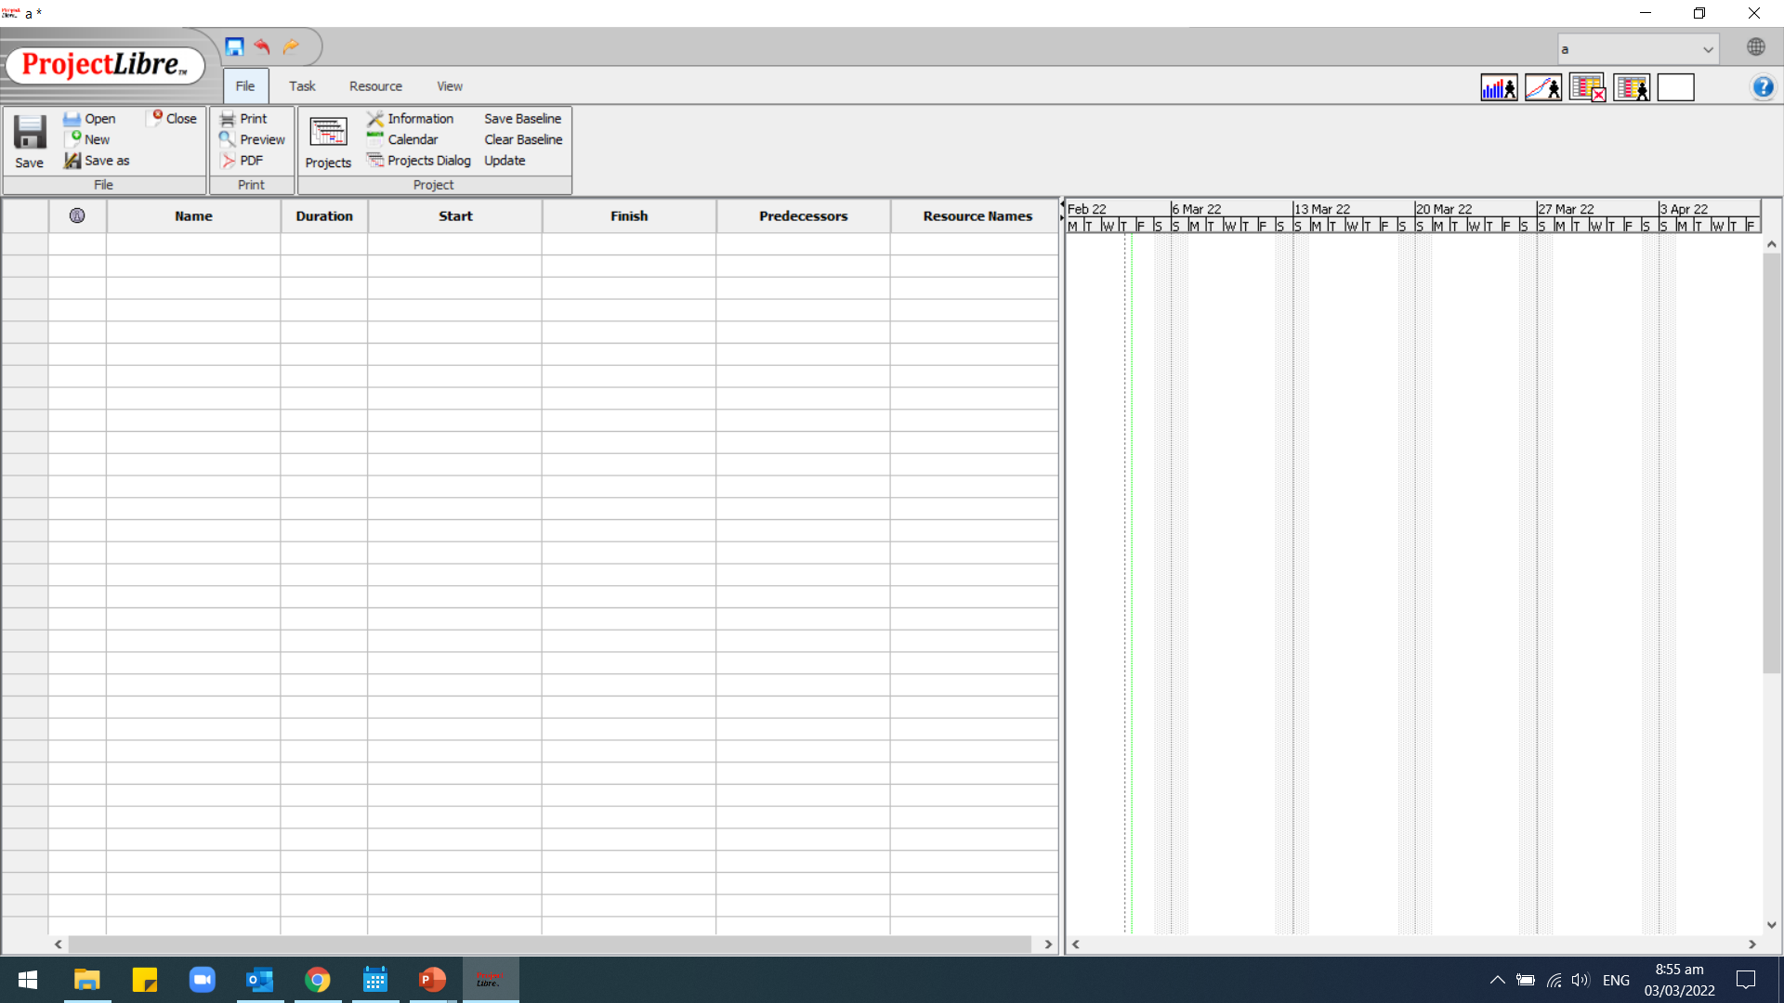
Install Project Libre Software
Download Project Libre from https://www.projectlibre.com/

Slide 45
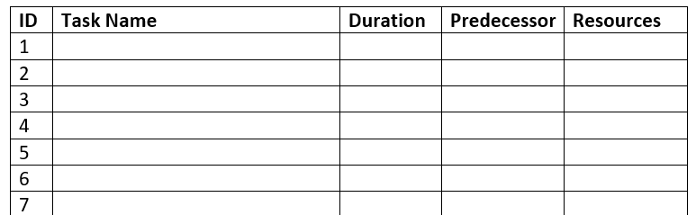
Part 3.1Gantt Chart
Develop Dependency Table
Using the details from the case study pg. 12-15
Identify the tasks, durations, predecessors
Use the Part 3 Guide document to record your details.

Slide 46
Using Project Libre
Please refer to Video: Project Libre Part 1- Basic Gantt
Available on SAM VLE

Slide 47
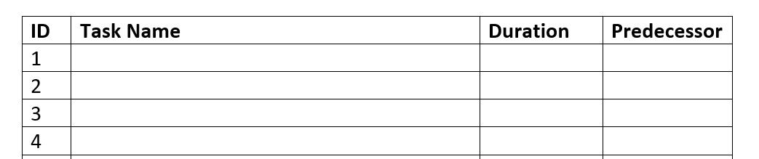
Steps to Build Gantt Chart
1. Complete dependency table with:
Id
Task name
Duration
Predecessor
2. Document your Assumptions:
Holidays
Start date
etc

Slide 48
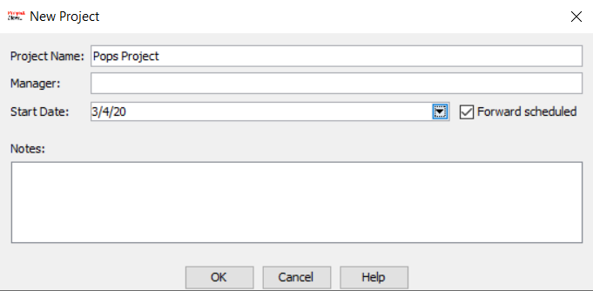
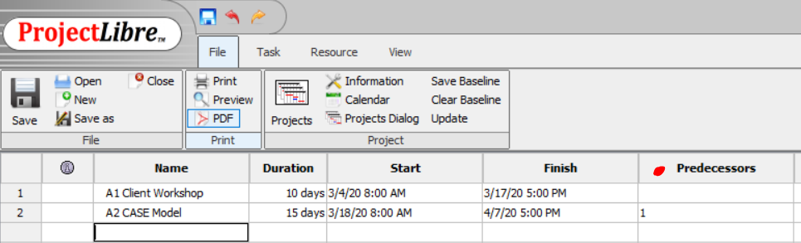
3. Open Project Libre
Click Create Project
Enter Project Name
Enter Project Start Date
To set milestones:
Create a milestone task name
Set Duration to ‘0’ days
4. Enter Task name, Duration and Predecessor into rows

Slide 49
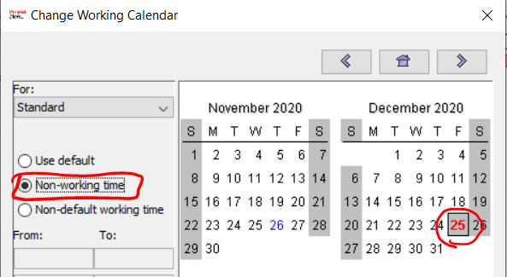
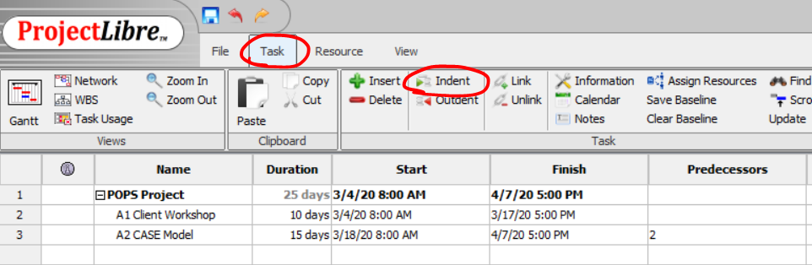
5. Add holidays
On FILE go to CALENDAR
Select dates
Set to NON-WORKING TIME
Repeat for all holidays
6. Add Project Summary Task
Insert New Task above task 1
Right click on ID 1
Choose New
Type in Name of Project
Select all Task below
On TASK click INDENT

Slide 50
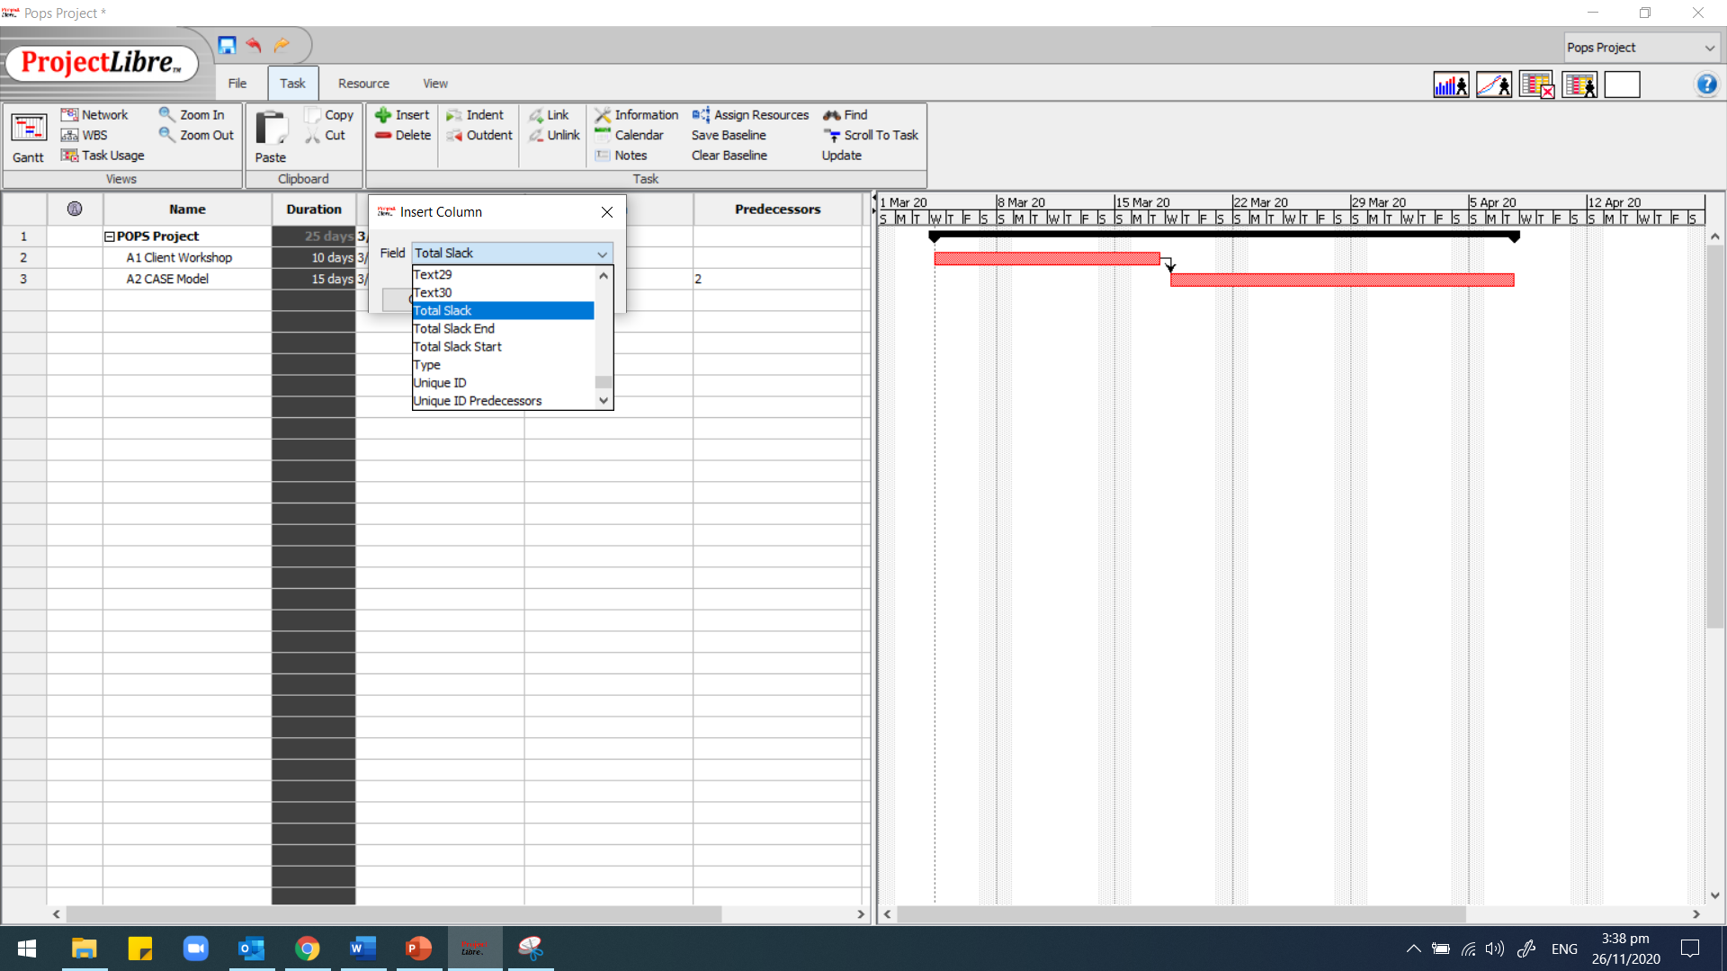

7. Add Total Slack Column
Right Click on Duration Column heading
Choose Insert Column
On Dialog box, choose Total Slack

Slide 51
Summary
Addressed the following aspects…
Many researchers propose that it is more costly to make changes later into the project lifecycle.
A network chart will always give valuable insight into how the project will be executed.
Project staff will be able to plan ahead using this information: they will have the planned start and finish times for each activity (usually converted into dates)
Critical tasks will receive the close attention they deserve (if they slip, the entire project will slip - unless the delay can be recovered)
The amount of float on non-critical tasks will be calculated - also very useful to know.
Overall, the project will stand a greater chance of finishing on schedule. There is software for this analysis.
You will learn MS Project for scheduling projects

Slide 52
Self-study activities
Read Chapter 6: Time Planning of Maylor (Kortext)
Start planning the structure of part 2a
Have a go at the practice quiz
Use the videos, as required, to practice your Project Libre skills

Slide 53
Any questions
?
?
?
?
?
?
?

Slide 54
References
Beck, K. and Andres, C. 2004., Extreme Programming Explained: Embrace Change 2nd ed. Harlow: Pearson Education
Boehm, B., 1976. Software Engineering. IEEE Transactions on Computers 25 (12), pp. 1226-1241
Maylor, H. 2017. Project Management 4th ed. Harlow: Pearson Education
MacLeamy, P. 2004. The future of the building industry - the effort curve [video online] HOK Network. Available at: <https://www.youtube.com/watch?v=9bUlBYc_Gl4> [Accessed 24 May2021].
Paulson, B., 1976. Designing to reduce Construction Costs, Journal of the Construction Division. 102 (C04), pp. 587-592.

